Slide 1
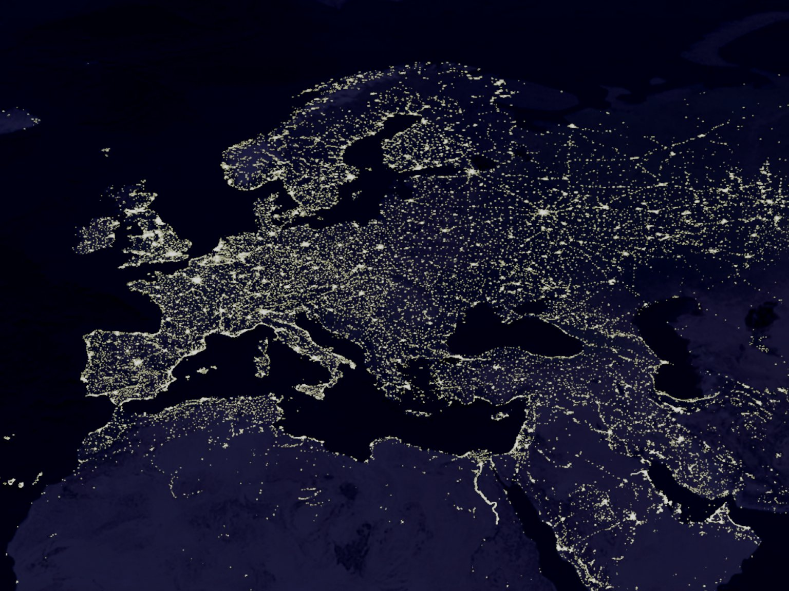
What is Social Geography??

Slide 2
Agenda:
What is Social Geography:
what is the social in geography;
the geography in the social?
What do we mean by Society, space and place?
The Socio-spatial Dialectic:
Public Geography

Slide 3
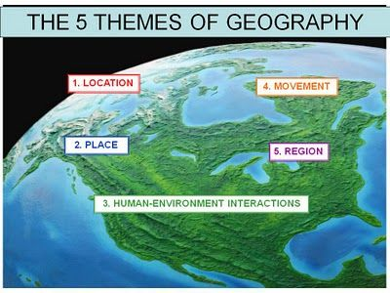
Social Geography
Social Geography is a subfield of Human Geography; it is the study of social practices across space and time.
Social Geography is more than a century old; Term coined in 1895 by Elisee Reclus
Concern: primarily with the way space mediates the production and reproduction of social divides—class, race, gender, age, sexuality, disabilities—over time. How these differences arise, why & where social categories of people cluster; how those categories of difference shape interaction….
Defined: Social Geography has been defined
as the study of social relations/interactions
(between people) and the spatial structures
that underpin those relations.
https://www.youtube.com/watch?v=pDiA4xWtH7Y

Slide 4
Social Geography Over Time:
Evolved from viewing “society” as a residual of cultural traits demarcated by national, linguistic, environmental or other barriers; with characteristics of the social reduced to demographic (descriptive) data.
To
A focus on social institutions (family, educational, political, economic…); the social relations among people and (fluid) categories of people; & the social and emotional content of relations that tie people to our physical object-world of things; Thus, networks of social relationships, collective sens of connectivity and social relationship among individuals across space.
Space has evolved from a conceptualization in which social characteristics are mapped and relations unfold on space– with the environment used to explain social differences among population groups.
To
An understanding of the socially constructed nature of space & place; that most differences between people are not the results of inherent characteristics. Note: Space tends to be more abstract than place; place can be understood as space that has specific meaning.
Space and Society as co-determinate of outcomes over time.

Slide 5
The Spatial Dialectic
For SGers, Social Behavior and Social Relations are Spatial:
There are connections between where you are (the physical and cultural/symbolic/social characteristics of place and the people around you) and
Who you are
Your relationships with Others
Your life chances (affected by access to key resources)
Your understanding of your world and your place in that world (del casino, p. 24)
Space is not static: People create, reinforce, and modify space thru actions & language
Thus:
Space shapes society
The Social Spatial Dialectic (p. 5).
Society shapes space

Slide 6
Some Themes:
Exclusion: Social geography emphasizes how structure and socio-spatial processes regulate and reproduce social exclusion and oppression over time:
Emphasizes a multidimensional view of inequality; where income doesn’t map directly onto class—the importance of intersectionality (del casino, p. 250).
Concerned with social issues affecting people’s lives (eg. class, gender, poverty,…) and the role of space in the creation of social relations, identities, social inequalities and oppression.
Concerned with space and place as defining processes of inclusion/participation/belonging and processes of exclusion/marginalization/othering.
Policies: Social Geography speaks to how policies and practices make experiencing different kinds of space—at home, at work, in schools, hospitals, prisons, etc—divided and unequal.
Liberation: Social Geography seeks to understand in order to alter the increasing entrenched and unaccepted nature of exclusion and inequality; justice—the normative turn: not simply how things are but what they could/should become.

Slide 7
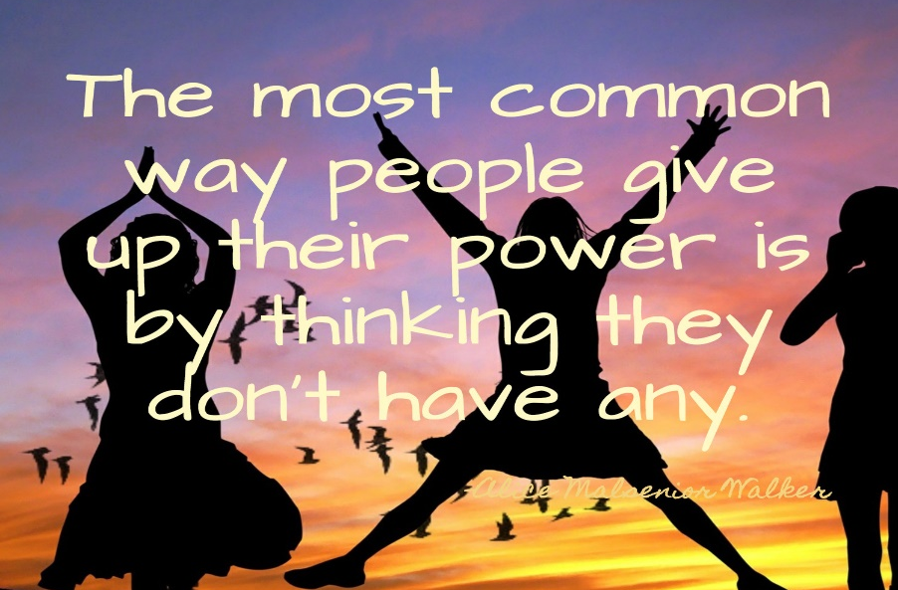
Social Geography in the 21st Century
SG is methodologically and theoretically diverse; yet all SGers are motivated by a quest to understand how the social world works & with respect for the power of geography in accounting for this.
2) Today there is greater emphasis on
Social Justice: the social has been reframed to express more directly the materiality of social life.
Relevance: calling for practical action inside and outside the academy; a new urgency emerging from the critiques of globalization and neoliberalism.
Participatory Research: collaboration in partnership with
those traditionally the “subjects” of research.

Slide 8
Public Geography
Raises the question of knowledge for what and for whom:
Knowledge: In PG, knowledge is produced through interaction and communications between geographers and publics for the benefit of the publics.
Dialogue: PG is an approach to generate discussion among various “publics” to promote and inform public debate about deepening class and racial inequalities, new gender regimes, environmental degradation, market fundamentalism, state and non-state violence.
Action: PG is about understanding patterns of exclusion, inequality, & bringing public attention to violence and oppression and their causes; And articulate a vision of the future based on equality, justice, peace and popular democracy that originates from a dialogue with marginalized and oppressed people.

Slide 9
Conclusion
Human life is mediated by geography; with space and place key to understanding how inequality unfolds and is experienced.
Social Geography is a field of knowledge and a way of knowing and understanding the world.
While there is no one social geography, social geographers are driven by questions that intersect with other critical objects of analysis, including nature, economy, politics, culture.
There remains at the core of all Social Geographical analyses a concern with the “Social”;
How the social is constructed in and through societies.
How societies are intertwined through larger processes and practices beyond the immediate boundaries.
Social geography remains committed to understanding and resolving issues of inequality and difference. Or “who gets what, where and how?” (David Smith) and the fairness of who gets what, where and how.

